Slide 1
Handling Deadlocks in Distributed Systems

Slide 2
Deadlocks
Deadlocks is a fundamental problem in systems.
A process may request resources in any order, which may not be known a priori and a process can request resource while holding others.
If the sequence of the allocations of resources to the processes is not controlled, deadlocks can occur.
A deadlock is a state where a set of processes request resources that are held by other processes in the set.

Slide 3
Deadlocks
The problem appears in standard systems too.
An Operating System can work on this problem at multiple levels:
Detect deadlocks
Recover from deadlocks
Prevent deadlocks
Various algorithms exist for these problems.

Slide 4
Example- Deadlock
Process A
Lock A
Lock B
Transfer
Unlock A
Unlock B
Process B
Lock B
Lock A
Transfer
Unlock B
Unlock A

Slide 5
Lets Recollect Deadlocks

Slide 6
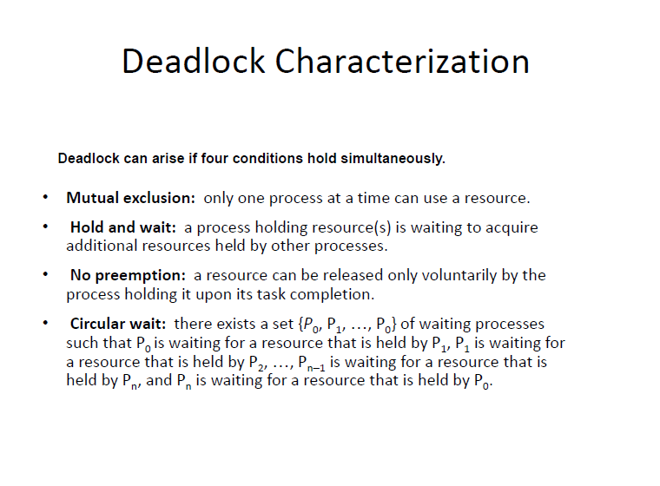
Revision

Slide 7
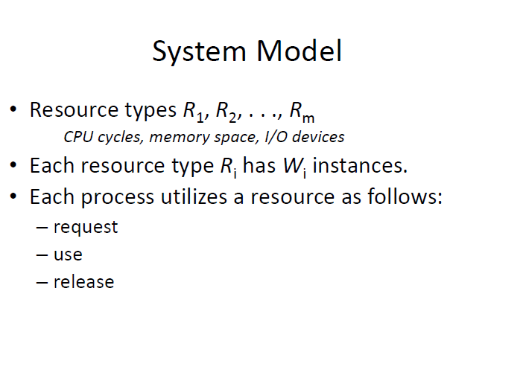

Slide 8
System Model
A process can be in two states:
Running or blocked.
In the running state (also called active
state), a process has all the needed resources and is either executing or is ready for execution.
In the blocked state, a process is waiting to acquire some resource.

Slide 9
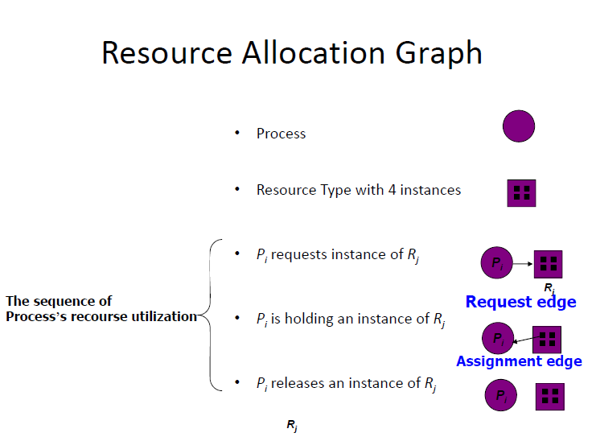

Slide 10
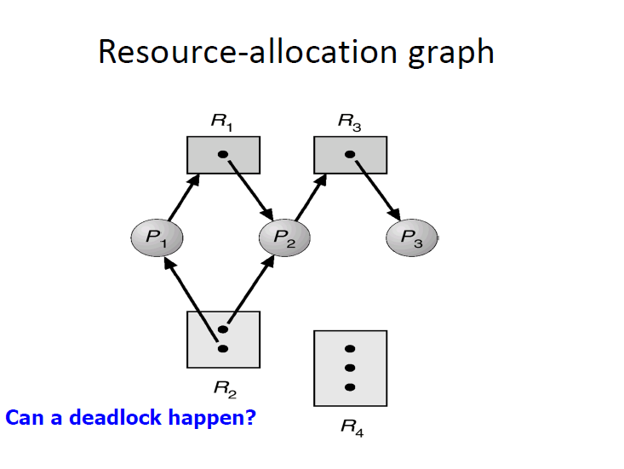
Does cycle indicate deadlock?

Slide 11
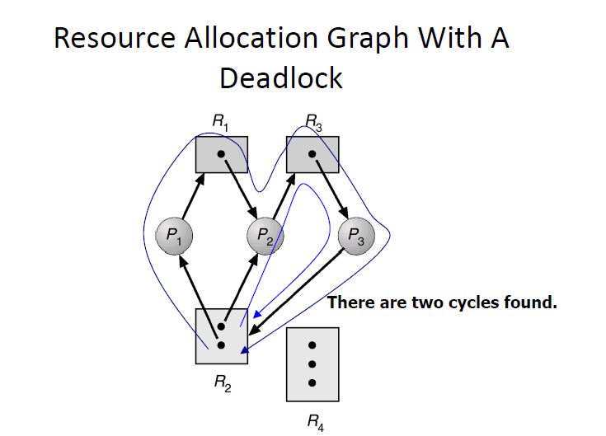

Slide 12
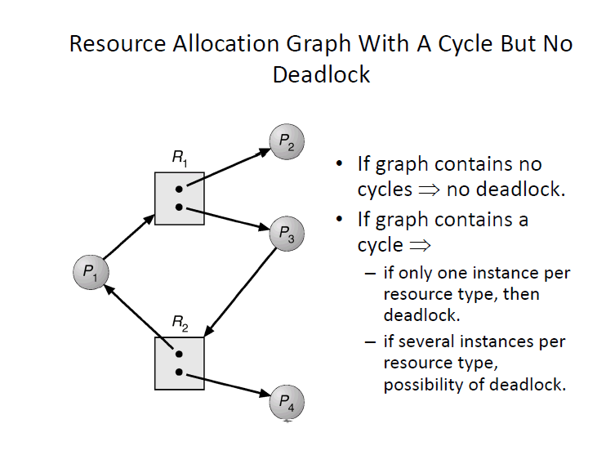

Slide 13
Wait for Graph
A wait for graph(WFG) is a graph where nodes are processes and there are edges from node P1 to node P2 if P1 is blocked and it is waiting for P2 to release some resource. A system is deadlocked iff there is a cycle or knot in the WFG

Slide 14
Challenge
Once a deadlock, the deadlock wont go away so can take time to detect it. Issue is we might detect false deadlocks because we can not capture the global picture locally and while we wait to understand who is waiting for whom the dependencies keep changing. The wait for cycle you might have sketched might be a false one.

Slide 15
To the Distributed Setting
A distributed program is composed of a set of n asynchronous processes p1, p2, . . . , pi, . . . , pn that communicate by message passing over the communication network.
Without loss of generality we assume that each process is running on a different processor.
The processors do not share a common global memory and communicate solely by passing messages over the communication network

Slide 16
To The Distributed Setting
There is no physical global clock in the system to which processes have instantaneous access.
The communication medium may deliver messages out of order, messages may be lost garbled or duplicated due to timeout and retransmission, processors may fail and communication links may go down.

Slide 17
To The Distributed Setting
We make the following assumptions:
The systems have only reusable resources.
Processes are allowed to make only exclusive access to resources.
There is only one copy of each resource
Hence a system is deadlocked iff there exists a cycle or knot in WFG

Slide 18
Resource Request Models
The manner in which a task asks for resources can be
Single Resource request Model: can have at most one pending resource request
AND Resource request Model: Can request multiple resources. Task resumed only when all are acquired.
Example: (R1 AND R2 AND R3)
OR Resource request Model: Can request multiple resources. Task can resume when any one of the request resources becomes available Example: (R1 or R2) or (R1 or R2 or R3)
AND OR Resource request Model: Any combination of AND and OR. Example: X AND ( Y OR Z) detecting using WFG does not directly wok but algorithms work on doing repeated OR tests over time (as deadlocks dont go away)

Slide 19
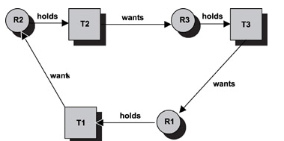
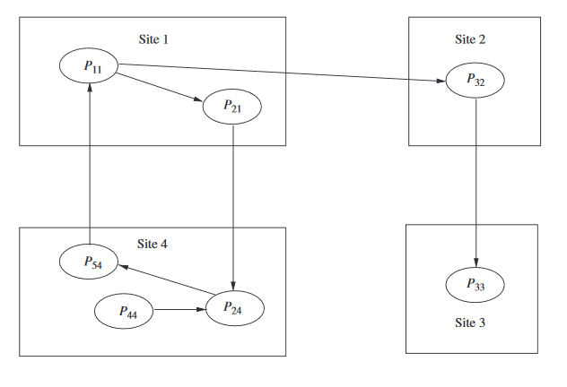
Single Resource Request
Model Presence of cycle indicates deadlock?
AND Resource request Model
If there is a cycle then there is a deadlock? there is a process deadlocked then will it be part of a cycle?
Notes:
AND Model: Process part of cycle indicates is deadlocked but not vice versa.. P44 is deadlocked as it is connected to a cycle

Slide 20
OR Resource request Model
If there is a cycle then there is a deadlock?
A knot(K) consists of a set of nodes such that for every node a in K,
all nodes in K and only the nodes in K are reachable from node a.
(SCC with no outgoing edge?)
A knot indicates a deadlock in the OR Model.
Notes:
No. Once P33 done, P32 can work. Once P32 done P11 can work and is not deadlocked.
yes No. P44 can be deadlocked even though not in the knot. Note this diagram does not show knot as P32 is reachable from a possibleknot of P11,P21,P34 and P24 Lecture 27 Time 8 where for OR, every edge should be part of cycle.

Slide 21
OR Resource request Model
If there is a cycle then there is a deadlock?
No, P33, then P32 and then P11 will run
A knot(K) consists of a set of nodes such that for every node a in K,
all nodes in K and only the nodes in K are reachable from node a.
(SCC with no outgoing edge?)
A knot indicates a deadlock in the OR Model. Are processes in knot alone deadlocked? No..P44 too is
Notes:
No. Once P33 done, P32 can work. Once P32 done P11 can work and is not deadlocked.
yes No. P44 can be deadlocked even though not in the knot. Note this diagram does not show knot as P32 is reachable from a possibleknot of P11,P21,P34 and P24 Lecture 27 Time 8 where for OR, every edge should be part of cycle.

Slide 22
Deadlock Handling Strategies
Deadlock Prevention – does not require knowing global state but is slow and can even have starvation issues
Deadlock Avoidance –Not popular in DS as expensive. Requires knowing who has what and what more they may need
Deadlock Detection – most popular !as deadlock actually happening is rare. When you suspect deadlock then you initiate a deadlock detecton algorithm and then if there is one, you Prempt certain resources and then restart from that point.

Slide 23
Control Organization for Deadlock Detection
Centralized Control – One site constructs the global WFG and searches for cycles. It can maintain WFG continuously or when running deadlock detection. Disadvantage- Single point of failure
Distributed Control- Each node equally responsible for gathering global WFG and detecting deadlocks. Will initiate a wave or traversal to detect a deadlock. Cant know who blocked whom but will only if there is a wait for cycle and if he belongs to it so that he can abort himself and break the deadlock
Hierarchical Control :Nodes organised as a tree where each site detects deadlocks involving only its descendants. The lowest common ancestor of the sites involved in the deadlock will detect the deadlock.

Slide 24
Centralized Deadlock-Detection Algorithms
Ask every process about its wait for status and create a global wait for graph. Will this work?
Notes:
No because you might acquire the wrong graph. At T1 p1 - > p2 but at T2 p1 got it and completed. At T2 you checked at the other site and you found P2->p1
You put together p1->p2 and p2->p1 and conclude deadlock but thsi was at two different time stamps

Slide 25
Centralized Deadlock-Detection Algorithms
The Ho-Ramamoorthy Algorithms
The Two-Phase Algorithm Deadlocks don’t go away unless broken. Collect status twice. Take only those dependencies which are present in both. Any issues?
The One-phase Algorithm Uses process status table and resource status table . process status table contains resources that are locked or waited on for each process. resource status table contains processes using or waiting on each resource. Takes a dependency as valid only if both tables indicate it.

Slide 26
Centralized Deadlock-Detection Algorithms
The One-phase Algorithm process status table: the process’ information where for each process gives information about resources held or seeked after.
Resource status table: Processes to which the resource is allocated to or seeking it
Gather this from all sites and create WFG if tables gathered from both sites say the same information. That is site 1 says P waits for R which is on site 2. Site2 also says P requested for R
Can we have false deadlock?

Slide 27
Centralized Deadlock-Detection Algorithms
Consider a false cycle by P1(site1), R1(site 2), P2(site 3) and R2(site 4) that the two phase algorithm detected where at
At site2 we had P1->R1->P2 and
At site4 we had P2 -> R2 -> P1
When the information from site1 is collected it says either P1->R1 or R2->P1. Since it wont say both you cannot construct a cycle though site 2 and site 4 might indicate P1->R1->P2 and P2 -> R2 -> P1

Slide 28
Distributed Edge-Chasing Algorithm
A probe is sent by a blocked
process to the process holding the resource.
- Probe is a triplet (I, J, k)
I: ID of blocked process
J: ID of process sending the message
K: ID to which message is sent
If probe is received by a blocked process, it edits and forwards the probe to the processes holding the resource it requires
If initial blocked process receives back its probe; it declares deadlock
Chandy Misra Haas Algorithm

Slide 29
Distributed Edge-Chasing Algorithm
Chandy Misra Haas Algorithm
To determine if a blocked process is deadlocked
if P_{i} is locally dependent on itself
then declare a deadlock
else for all P_{j} and P_{k} such that
(a) P_{i} is locally dependent upon P_{j}, and
(b) P_{j} is waiting on P_{k}, and
(c) P_{j} and P_{k} are on different sites,
send probe (i, j, k) to the home site of P_{k}

Slide 30
On the receipt of probe (i, j, k), the site takes the foll. actions:
if (a) P_{k} is blocked, and
(b) dependent_{k}(i) is false, and //Pk knows of I’s dependency on it.
(c) P_{k} has not replied to all requests of P_{j},
then begin
dependent_{k}(i) = true;
if k = i then declare that P_{i} is deadlocked
else for all P_{m} and P_{n} such that
(i) P_{k} is locally dependent upon P_{m}, and
(ii) P_{m} is waiting on P_{n}, and
(iii) P_{m} and P_{n} are on different sites,
send probe (i, m, n) to the home site of P_{n}
end.

Slide 31
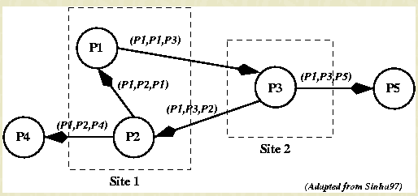

Slide 32
Mitchell and Merritt’s Algorithm for single resource model
Works on the single resource model Belongs to the class of edge-chasing algorithms where probes are sent in opposite direction of the edges of WFG.
Each node has two labels- Private and Public where initially both has same values
Private is unique but might change
Has four nondeteministic state transitions
- Block, Transmit, Detect, Activate
Notes:
https://groups.csail.mit.edu/tds/papers/Merritt/podc84.pdf
No phantom deadlocks as long as process’ dont fail.

Slide 33
Automatic detection of cycle – no one has to keep checking for it

Slide 34
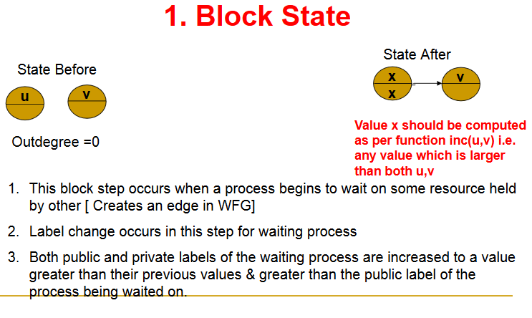
The value incremented to has to be unique to that node.

Slide 35
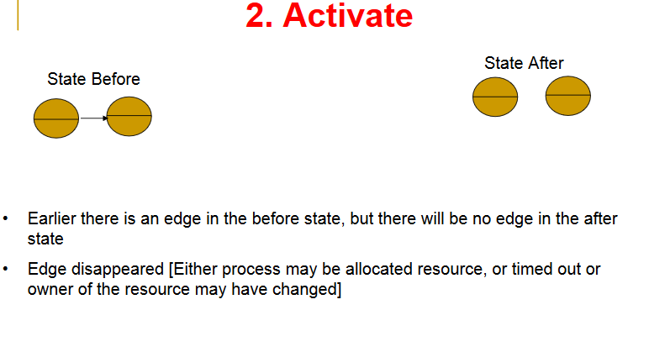

Slide 36
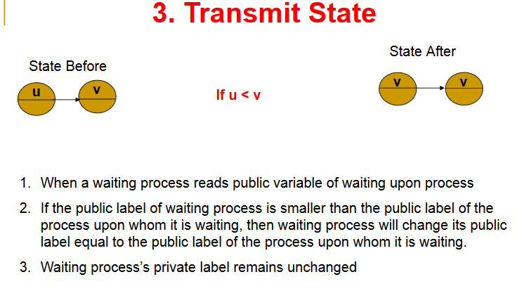
Notes:
This is different from block state because in the block state the edge is getting created and the value of the waiting process has public private label set to value grt than public of waited on process. Here the edge is already there but the value of the waited on process changes making u<v. In such a case the waiting process changes his public value to v.

Slide 37
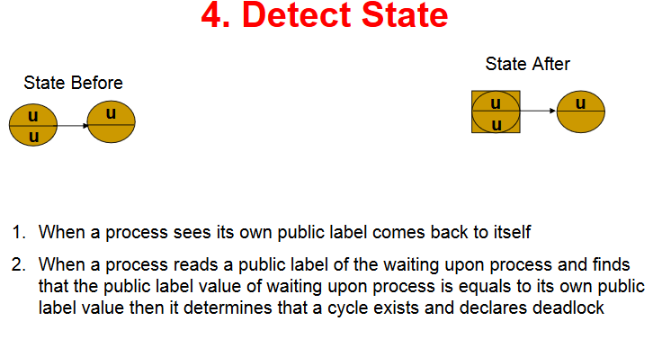

Slide 38
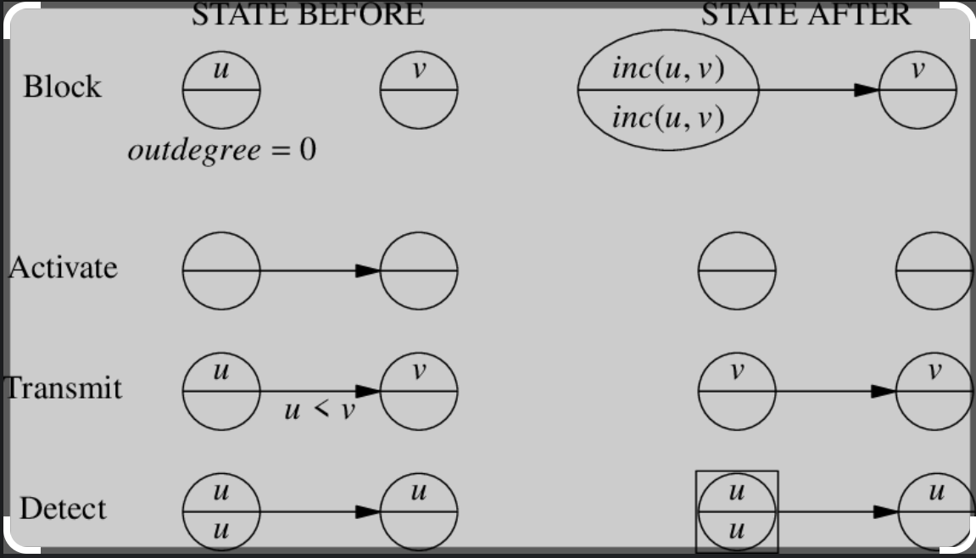

Slide 39
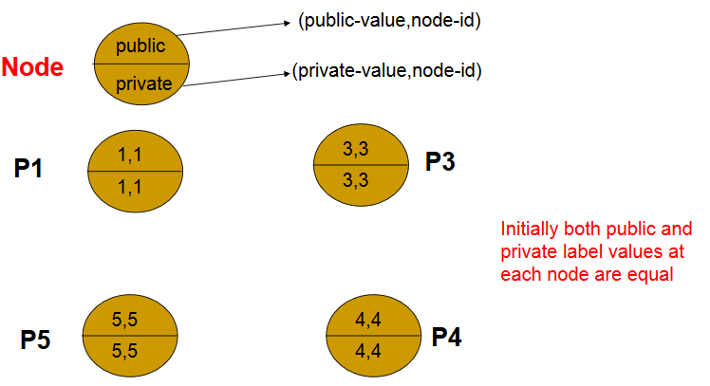
You can either use a tuple as above for public and private labels where second value of each tuple is process id or you can use single values ensuring unique public values by inc function

Slide 40
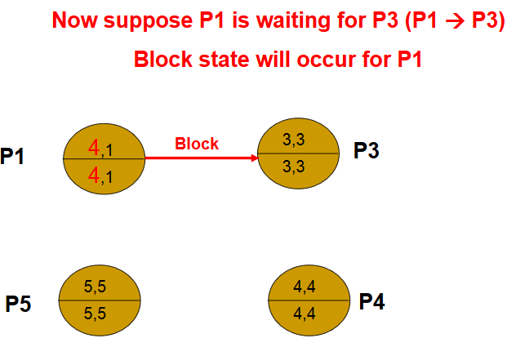

Slide 41
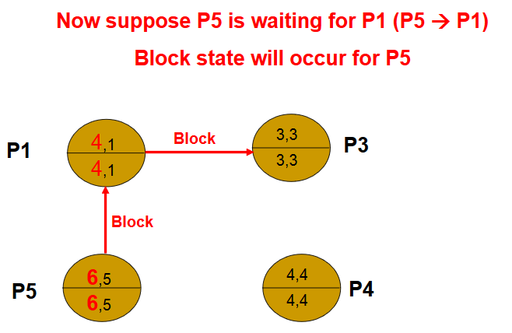

Slide 42
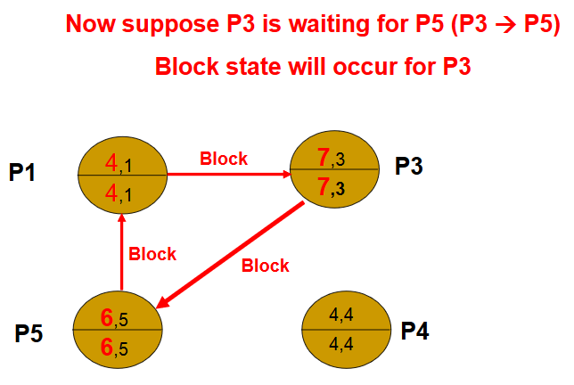

Slide 43
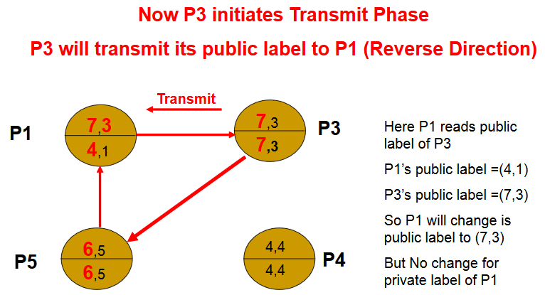

Slide 44
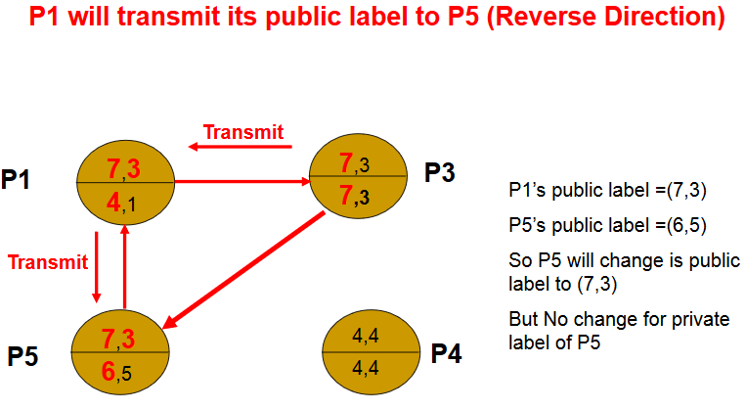

Slide 45
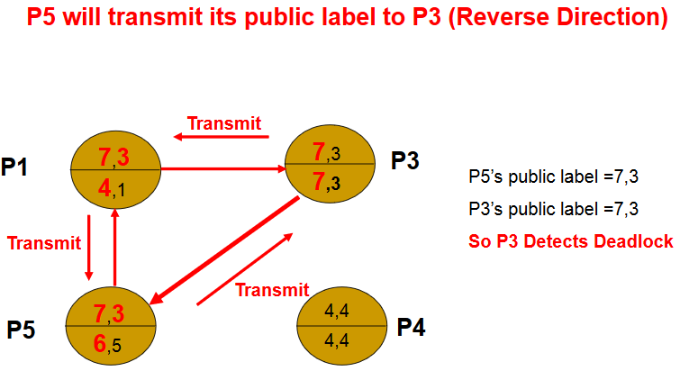

Slide 46
Questions
Can a node be part of multiple cycles?
Suppose a node has added the last edge of a cycle and hence started a transmit. Can his private and public label change by the time the transmit reaches him back?
Does the start of a transmit imply the presence of a cycle?

Slide 47
Can another node also have your public value though not in a cycle?
In case of a cycle, the process that detects the deadlock with have the highest public id in the cycle. T/F?
Can a process ignore a transmit probe if the value is lesser than its own.

Slide 48
H.W Can there be phantom deadlocks?
H.W Is the last process to block same as the one who detects the deadlock?

Slide 49
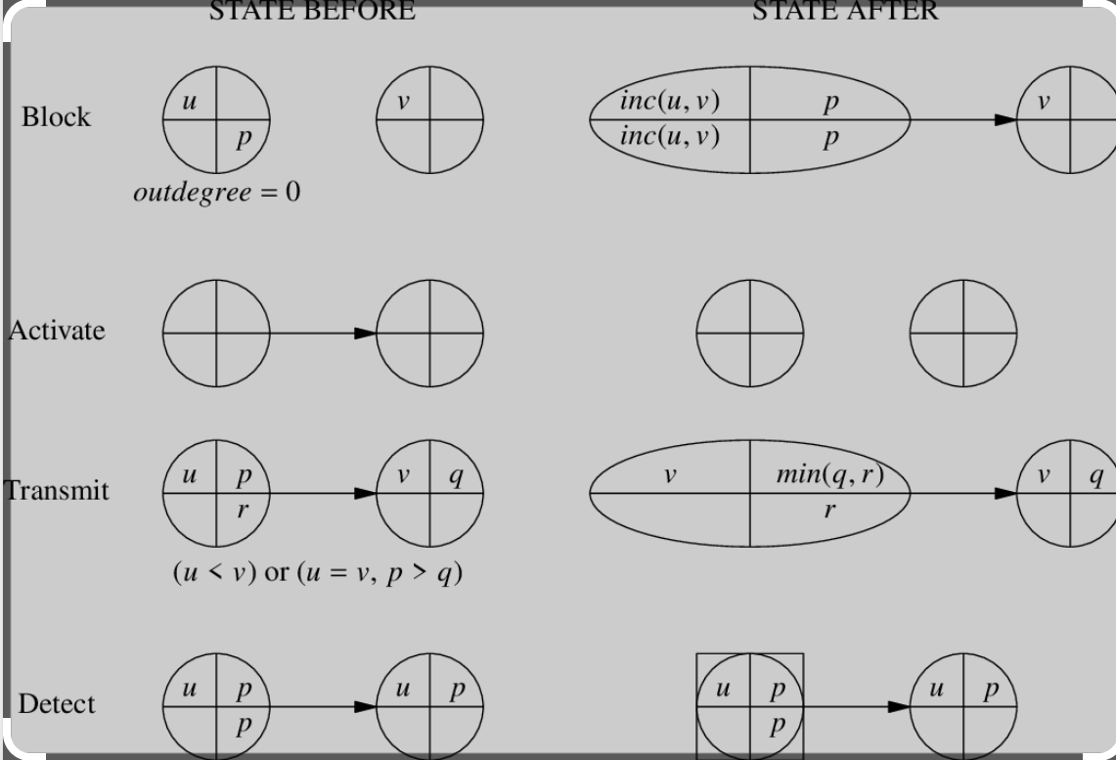
With Priority. Higher Number indicates Higher Priority

Slide 50
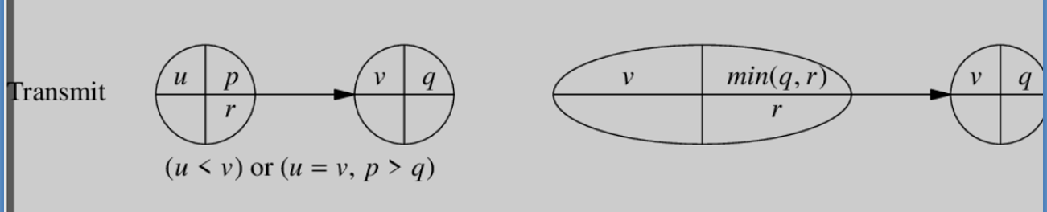
Transmit with Priority
If u>v : no transmission
If u<v: should transmit . Let the new public tuple of the blocked node be (a,b). Then, a=v because transmission should happen. b should be the lowest in the transmitted chain so that on transmission in a cycle; the lowest priority finds his own public label and priority number and aborts.
If u==v; then, if p>q that means transmission should continue so that lower priority process aborts. Consider example in the pdf

